Slide 1
Short Term Fund concept

Slide 2
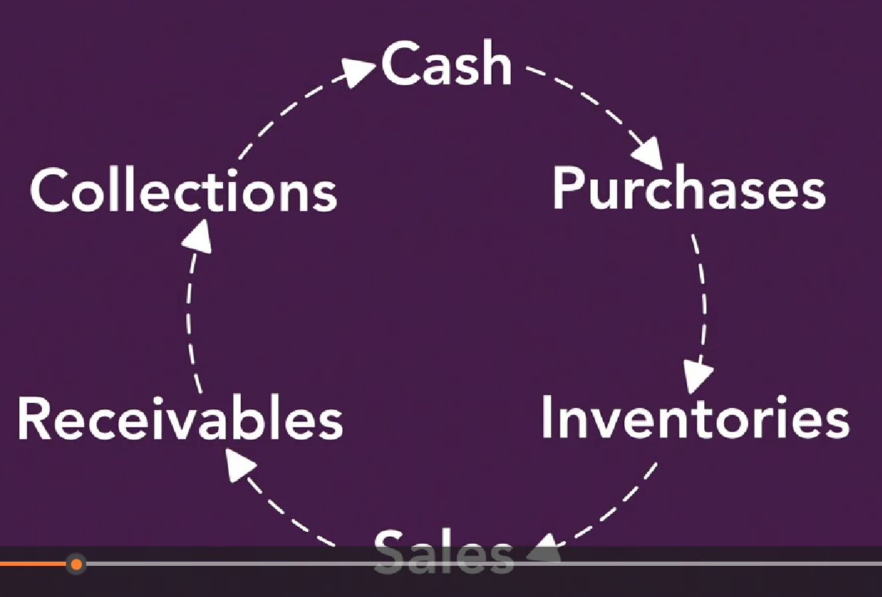
Managing Resource
You need detailed and timely information

Slide 3
Predictive Marketing

Slide 5
Tool to manage Cash

Slide 6
Cash Management
Line of Credit
Fund in advance
Short term investment
Money-market fund

Slide 7
Receivable Management
Credit term is a marketing tool

Slide 10
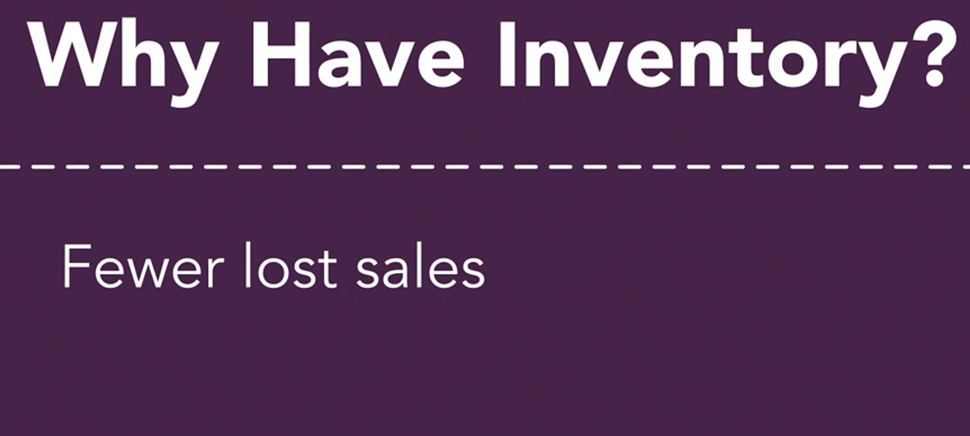
Inventory Management

Slide 16
Long Term Fund concept

Slide 20
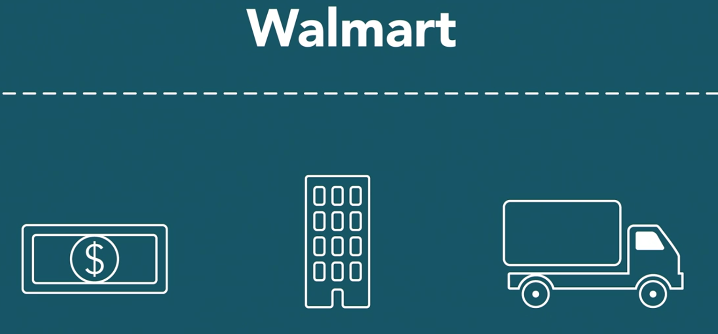

Slide 21
